Slide 1


HSG Spin-Off Barometer 2023
Demonstrating resilience in uncertain times.
Results of the annual survey among HSG Spin-Offs

Slide 2

Markets may go up, and markets may go down.
But resilience is there to separate those that stay and those that do not.

Slide 3

Demonstrating resilience.
In the ever-changing entrepreneurial landscape, resilience has emerged as a critical success factor, especially in the face of unprecedented challenges and uncertainties.
With increasing global crises, geopolitical tensions, rapid technological advancements and socio-economic shifts, the resilience of start-ups and scale-ups is being put to the test.
This year's HSG Spin-Off Barometer focuses on resilience and examines how the start-ups and scale-ups surveyed have not only weathered storms but also thrived in the midst of adversity.
Through proactive strategies, dynamic responses and an unwavering commitment to their vision, HSG Spin-Offs embody the resilience needed to overcome obstacles and seize opportunities in an uncertain world.
The spin-offs surveyed demonstrate a global presence and cross-sector innovation, have identified resilience as a key characteristic for their success in uncertain times and have an optimistic business outlook despite economic challenges.

Slide 4
Introduction to the HSG Spin-Off Barometer 2023
Building and promoting the entrepreneurial community at the University of St.Gallen
Startup@HSG is part of the Prorectorate for Innovation & Quality (PIQ) and promotes the entrepreneurial community at the University of St.Gallen. It is the first contact point for (aspiring) entrepreneurs.
As part of our activities, we have been awarding the spin-off label since 2017 and it is currently held by 145 start-ups (“HSG SpinOffs”). Throughout the whole year, we accept applications from high-potential founders and startups that fulfill the HSG Spin-Off selection criteria:
HSG Origin: The product/service and at least one co-founder have an HSG background.
Innovation & Sustainability: The product/service is innovative and sustainable.
Founder team: The founder demonstrate a strong entrepreneurial mindset and behaviour.
Activity: The company or startup is active for at least 12 months.
Scalability: The business model shows strong growth potential.
Benefit for Switzerland: The Swiss economy is likely to benefit if the company is successful.
Each year, we conduct the HSG Spin-Off Barometer, i.e., a comprehensive survey among all HSG Spin-Offs, to track trends and developments in the HSG Startup Ecosystem.
For 2023, among many other topics, we focus on resilience as the guiding theme and how external shocks are impacting the business activities of HSG SpinOffs.

Slide 5
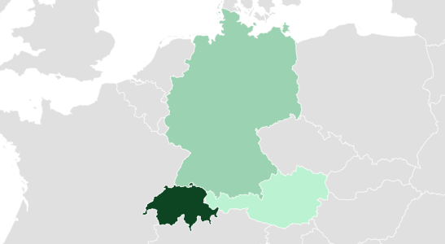
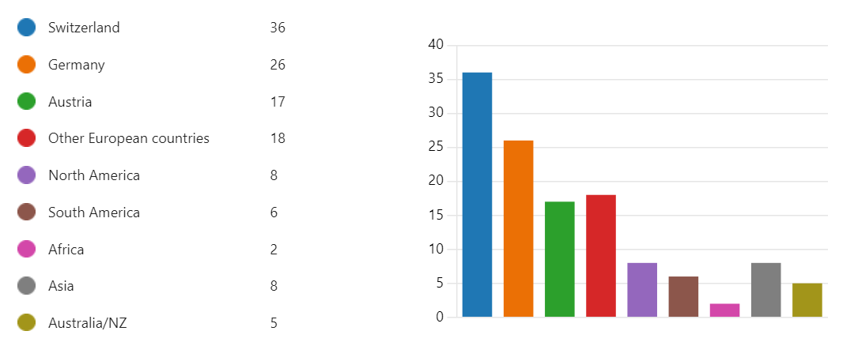
HSG Spin-Offs are headquartered all around the globe
The HSG Spin-Off community reaches far beyond Switzerland and the DACH region and, thereby, reflects its international impact.
35.1%
91.1%
5.4%
Geographical areas of business operation of HSG SpinOffs - 2024
All HSG Spin-Offs have established their headquarters or a main administrative office in Switzerland (91.9%), Germany (35.1%), Austria (5.4%) or two of them (percentages therefore add up to more than 100%).
The DACH- region is also their main area of operation. 11% of HSG Spin-Offs, especially those that show higher levels of maturity and venture size, are active on an international level of business operations that expands the DACH-region and also the boundaries of the European context.

Slide 6
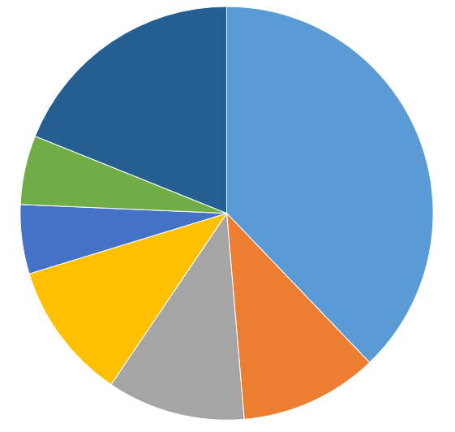


HSG Spin-Offs are active in a broad spectrum of industries
Within this broad spectrum, the largest proportion of HSG Spin-Offs is operating in technology-driven business segments.
37.8% of all ventures surveyed within this year‘s HSG Spin-Off Barometer are operating in the business segment of „Technology, Media and Telco“. This business area is followed by the Financial Services, Consumer Packaged Goods and Real Estate segments, which each account for 10.8% of all ventures. The high prevalence of Financial Services ventures can be attributed to the business school character of the University of St. Gallen.
Prominent examples of ventures within this business segment are N26, which has built up a world-class reputation in recent years and offers innovative banking solutions to more than 8 million customers; as well as Kaspar&, a FinTech venture – in comparison to N26 – still in its earlier development stage that is offering smart investment and personal saving solutions to private individuals.
Areas of business activities of the surveyed HSG SpinOffs

Slide 7






































HSG SpinOffs survey sample
The HSG Spin-Off Barometer presents the survey results from the following 38 HSG Spin-Offs:
Overview of Survey Sample (HSG Spin-Offs) (N=38)
7

Slide 8
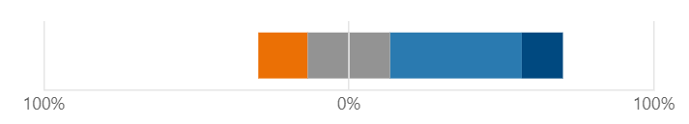
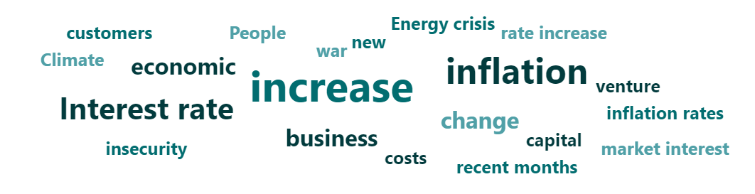
RESILIENCE – quo vadis?
Resilience is especially important in times of deteriorating business prospects. But: HSG Spin-Offs are optimistic about the future.
Global crises are shakening international and national markets. Levels of uncertainty and perceived risks are increasing.
Business prospects are worsening on an overall economic level, as captured for example by the European Union Business Confidence Indey which exhibited -9 points on average in the first quartile of 2024 (for more details, see https://tradingeconomics.com/switzerland/business-confidence#).
The good news: Even in these challenging economic times, the surveyed startups and spinoffs of the HSG SpinOff community show above-average high levels of business optimism and confidence in their positive business development.
Answers provided to the question: “In comparison to the general business situation one year ago, the general economic circumstances today are…”
Answers provided to the question: “What external, macro-level factors have most influenced the course of your venture's business in recent months?”

Slide 9
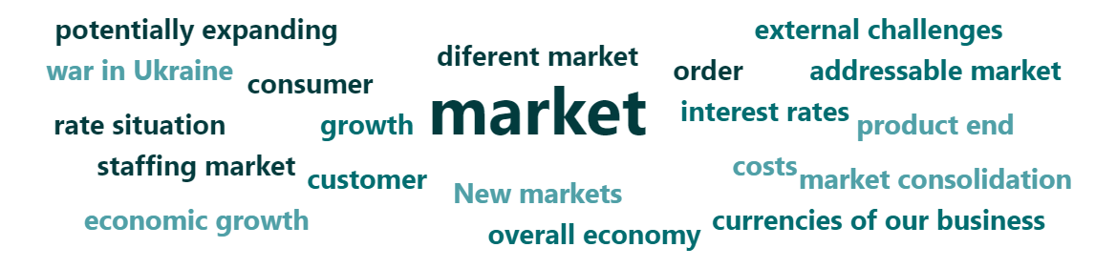
Deep dive: Macro-economic forces of change
Resilience is especially important in times of deteriorating business prospects. But: HSG Spin-Offs are optimistic about the future.
We asked the ventures of the HSG SpinOff community the following question „What are the main changes you are expecting within the next 12 months that have an direct impact on the course of business of your venture?” – and those are the comprised answers:
Worsening military crises in Ukraine and Israel as well as potentially Trump winning the US elections, leading to rising insecurity and lower consumer spending in Europe.
There is a lot of dry powder on the market, as a result of which we expect that raising will be a little easier then last year..
Slowdown in economic growth, job cuts and reduced consumer behavior.

Slide 10
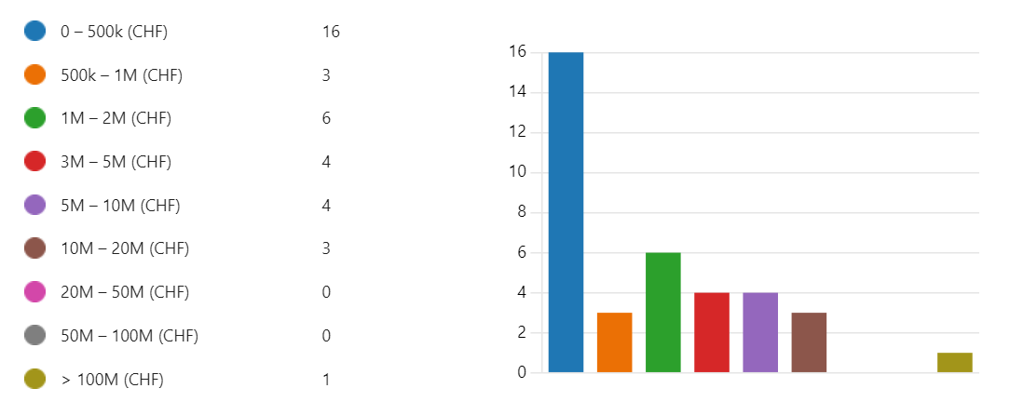
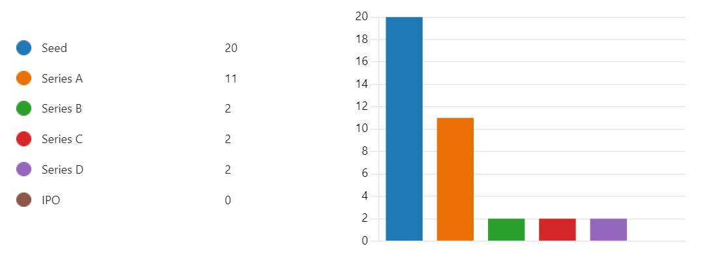
Funding situation of HSG Spin-Offs
HSG Spin-Offs perform well in securing funding from external investors across all stages of venture development.
Propelled by their high overall business quality and level of innovativeness, on average, HSG Spin-Offs have an easier time securing funding than other ventures. This was verified through qualitative descriptions of founders of HSG Spin-Offs of their past funding processes, in comparison to the commonly outlined structure of funding processes.
At the time of the survey for 2023 of the HSG Spin-Off Barometer, the average financing volume per venture was CHF 5.7 million, based on the data of the ventures surveyed.
Funding stage of surveyed HSG Spin-Off. Actual numbers may differ. As of 2024, two HSG spin-offs have gone public (IPO) - however, these did not take part in the survey for 2023.
Total amount of funding secured by HSG Spin-Offs surveyed within the HSG Spin-Off Barometer 2023.

Slide 11
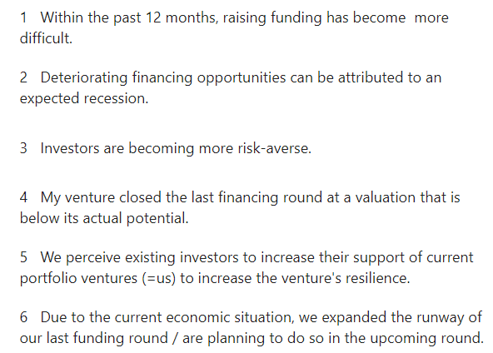
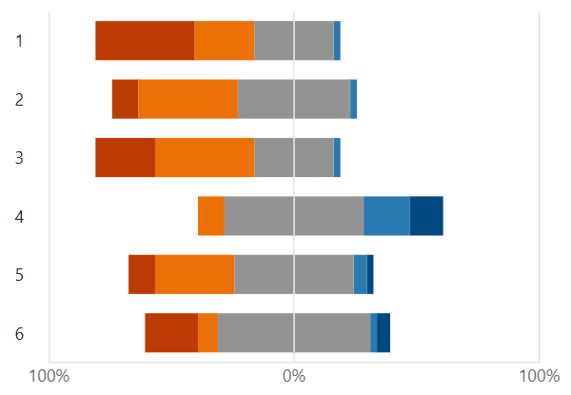

Impact on funding conditions for startups and scaleups
General economic conditions are also impacting the funding landscape. However, HSG Spin-Offs are optimistic on average.
HSG Spin-Offs are aware of the more challenging conditions to raise external funding, induced by tensions at the global markets. Fortunately, those startups and scaleups that are observing deteriorating funding conditions in their respective industry to large parts are equipped with a counter-strategy, such as expanding the runway of funding rounds to decrease liquidity and solvency risks.
Within the next 12 months, 45.9% of all surveyed ventures are planning to raise a funding round, with an average volume of CHF 6.9 million (overall range between CHF 70M and CHF 150K). The high overall average financing volume sought reflects the high level of developmentand maturity of HSG Spin-Offs. Increasing funding volumes are commonly associated with accelerated venture growth rates, which also suggests a positive development trend for HSG Spin-Offs in the future.
Answers provided to the question:
“Please rate how much you agree with the following statements about the funding conditions of startups in your industry.”

Slide 12



Do you have questions about the HSG Spin-Off Barometer 2023?
Or how STARTUP@HSG is supporting young ventures in general?
We are happy to assist you!
Vice-President's Board for Innovation & Quality
Prof. Dr. Dietmar Grichnik
Dr. des. Bernd Schneider - bernd.schneider@unisg.ch
Maria Luisa Fuchs - marialuisa.fuchs@unisg.ch
General questions: startup@unisg.ch
Akkreditierungen

